Slide 1
DeepPath: A Reinforcement Learning Method for Knowledge Graph Reasoning
William Wang
Department of Computer Science
University of California, Santa Barbara
Joint work with Wenhan Xiong, Xin Wang, and Thien Hoang
07/2017

Slide 2
Agenda
Motivation
Related Work
DeepPath
Experiments
Conclusions
UCSB NLP Lab at a glance.
Learning with visual cues.

Slide 3
Knowledge Graphs
English
serviceLanguage
countrySpokenIn⁻¹
personLanguages
Actor
Caesars Entertain…
personLanguages
profession
serviceLocation⁻¹
nationality⁻¹
Neal McDonough
United States
Tom Hanks
countryOfOrigin
castActor
awardWorkWinner
Graham Yost
writtenBy
Band of Brothers
music
Michael Kamen
tvProgramCreator
...
tvProgramGenre
HBO
Mini-Series

Slide 4
Benefits of Knowledge Graph
Support various applications
Structured Search
Question Answering
Dialogue Systems
Relation Extraction
Summarization
Knowledge Graphs can be constructed via information extraction from text, but…
There will be a lot of missing links.
Goal: complete the knowledge graph.

Slide 5
Reasoning on Knowledge Graph
Query node: Band of brothers
Query relation: tvProgramLanguage
tvProgramLanguage(Band of Brothers, ?)
English
serviceLanguage
countrySpokenIn⁻¹
personLanguages
Actor
Caesars Entertain…
personLanguages
profession
serviceLocation⁻¹
nationality⁻¹
Neal McDonough
United States
Tom Hanks
countryOfOrigin
castActor
awardWorkWinner
Graham Yost
writtenBy
Band of Brothers
music
Michael Kamen
tvProgramCreator
...
tvProgramGenre
HBO
Mini-Series

Slide 6
Related Work
Path-based methods
Path-Ranking Algorithm, Lao et al. 2011
ProPPR, Wang et al, 2013
Subgraph Feature Extraction, Gardner et al, 2015
RNN + PRA, Neelakantan et al, 2015
Chains of Reasoning, Das et al, 2017
Why do we need path-based methods?
It’s accurate and explainable!
Notes:
PRA: 1. finds potential path types between entity pairs
2. Computes random walk probabilities
SFE: replace random walk probabilities with binary features

Slide 7
Related Work
Embedding-based method
RESCAL, Nickel et al, 2011
TransE, Bordes et al, 2013
Neural Tensor Network, Socher et al, 2013
TransR/CTransR, Lin et al, 2015
Complex Embeddings, Trouillon et al, 2016
Embedding methods allow us to compare, and find similar entities in the vector space.

Slide 8
Our Approach: DeepPath
Learning the paths with RL, instead of using random walks
Model the path finding as a MDP
Train a RL agent to find paths
Represent the KG with pretrained KG embeddings
Use the learned paths as logical formulas

Slide 9
Machine Learning
Supervised
Learning
Unsupervised
Learning
Reinforcement
Learning

Slide 10
Supervised v.s. Reinforcement
Supervised Learning
◦ Training based on
supervisor/label/annotation
◦ Feedback is instantaneous
◦ Not much temporal aspects
Reinforcement Learning
◦ Training only based on
reward signal
◦ Feedback is delayed
◦ Time matters
◦ Agent actions affect
subsequent exploration

Slide 11
Reinforcement Learning
RL is a general purpose framework for decision making
◦ RL is for an agent with the capacity to act
◦ Each action influences the agent’s future state
◦ Success is measured by a scalar reward signal
◦ Goal: select actions to maximize future reward

Slide 12
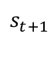
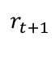
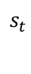
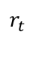

Reinforcement Learning
Agent
$$r_{t}$$
$$s_{t}$$
$$at$$
$$s_{t+1}$$
Environment
$$r_{t+1}$$
Agent
Environment
Multi-layer neural nets ѱ(s_{t} )
KG modeled as a MDP

Slide 13
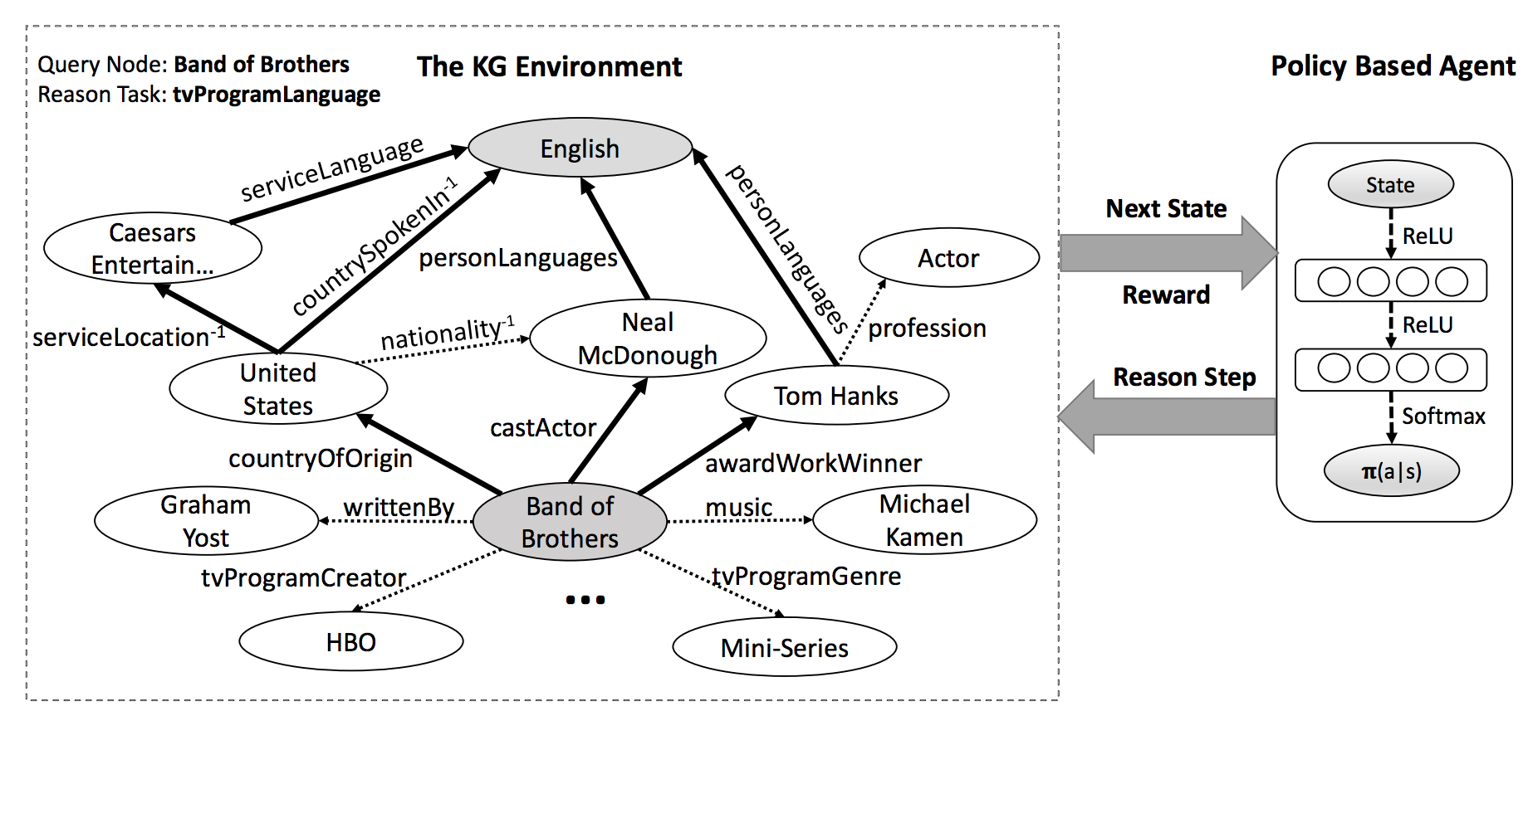
DeepPath: RL for KG Reasoning

Slide 14
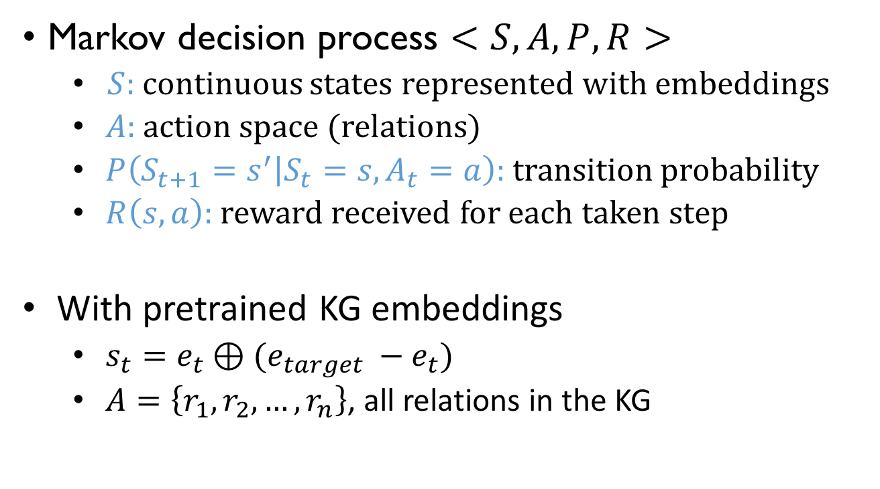
Components of MDP
Markov decision process $<S,A,P,R>$
$S:$ continuous states represented with embeddings
$A$: action space (relations)
$P\left(S_{t+1}=s^{′} | S_{t}=s, A_{t}=a\right):$transition probability
$R\left(s,a\right):$ reward received for each taken step
With pretrained KG embeddings
$s_{t}=e_{t}⊕(e_{target} −e_{t})$
$A=\left\{r_{1},r_{2},…, r_{n}\right\}$, all relations in the KG

Slide 15
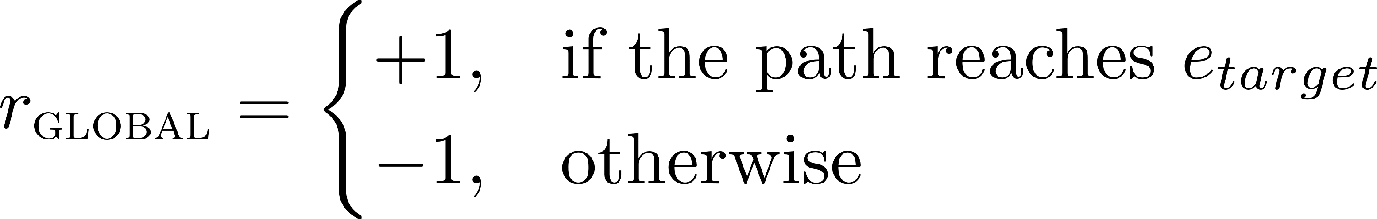
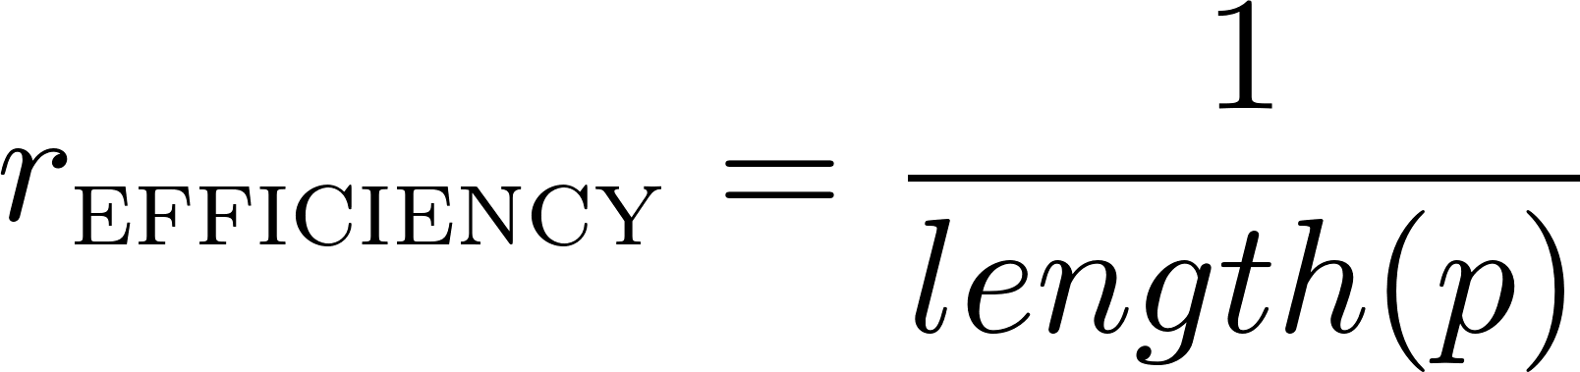
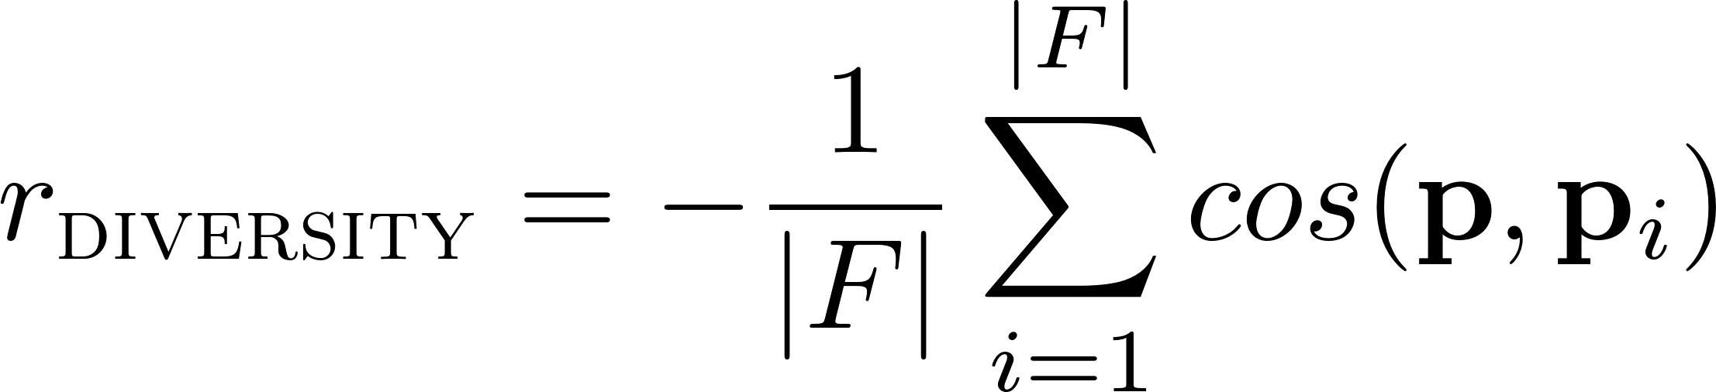
Reward Functions
Global Accuracy
Path Efficiency
Path Diversity

Slide 16
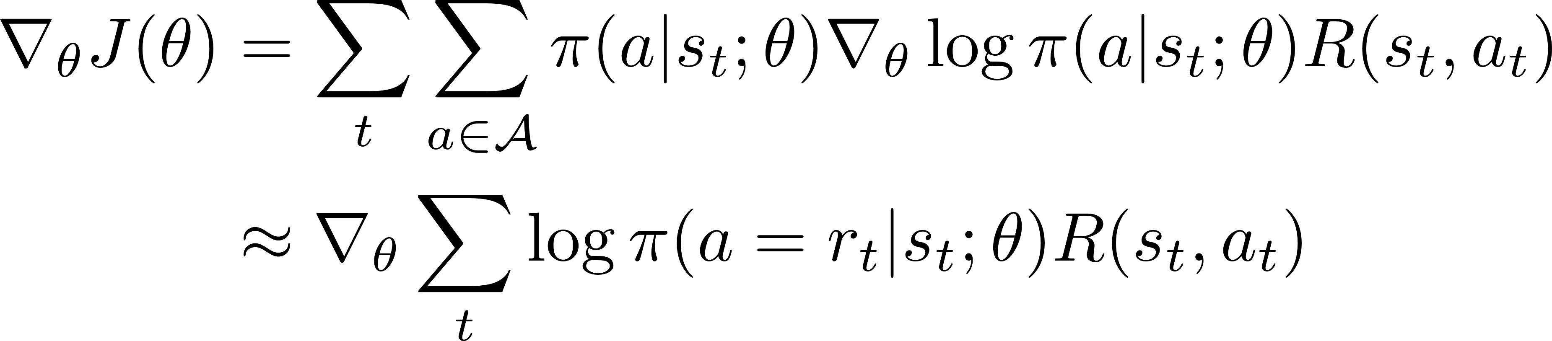

Training with Policy Gradient
Monte-Carlo Policy Gradient (REINFORCE, William, 1992)

Slide 17
Challenge
Typical RL problems
Atari games (Mnih et al., 2015): 4~18 valid actions
AlphaGo (Silver et al. 2016): ~250 valid actions
Knowledge Graph reasoning: >= 400 actions
Issue:
large action (search) space -> poor convergence properties

Slide 18
Supervised (Imitation) Policy Learning
Use randomized BFS to retrieve a few paths
Do imitation learning using the retrieved paths
All the paths are assigned with +1 reward

Slide 19
Datasets and Preprocessing
Dataset | # of Entities | # of Relations | # of Triples | # of Tasks
FB15k-237 | 14,505 | 237 | 310,116 | 20
NELL-995 | 75,492 | 200 | 154,213 | 12
FB15k-237: Sampled from FB15k (Bordes et al., 2013), redundant relations removes
NELL-995: Sampled from the 995th iteration of NELL system (Carlson et al., 2010b)
Dataset processing
Remove useless relations: haswikipediaurl, generalizations, etc
Add inverse relation links to the knowledge graph
Remove the triples with task relations

Slide 20
Effect of Supervised Policy Learning
x-axis: number of training epoches
y-axis: success ratio (probability of reaching the target) on test set
-> Re-train the agent using reward functions

Slide 21
Inference Using Learned Paths
Path as logical formula
FilmCountry: actionFilm⁻¹ -> personNationality
PersonNationality: placeOfBirth -> locationContains⁻¹
etc …
Bi-directional path-constrained search
Check whether the formulas hold for entity pairs
…
…
Uni-directional search
bi-directional search

Slide 22
Link Prediction Result
Tasks | PRA | Ours | TransE | TransR
worksFor | 0.681 | 0.711 | 0.677 | 0.692
atheletPlaysForTeam | 0.987 | 0.955 | 0.896 | 0.784
athletePlaysInLeague | 0.841 | 0.960 | 0.773 | 0.912
athleteHomeStadium | 0.859 | 0.890 | 0.718 | 0.722
teamPlaysSports | 0.791 | 0.738 | 0.761 | 0.814
orgHirePerson | 0.599 | 0.742 | 0.719 | 0.737
personLeadsOrg | 0.700 | 0.795 | 0.751 | 0.772
…
Overall | 0.675 | 0.796 | 0.737 | 0.789
Mean average precision on NELL-995

Slide 23
Qualitative Analysis
Path length distributions

Slide 24
Qualitative Analysis
Example Paths
placeOfBirth -> locationContains⁻¹
placeOfBirth -> locationContains
personNationality:
peoplePlaceLived -> locationContains⁻¹
peopleMariage -> locationOfCeremony -> locationContains⁻¹
tvCountryOfOrigin -> countryOfficialLanguage
tvProgramLanguage:
tvCountryOfOrigin -> filmReleaseRegion-1 -> filmLanguage
tvCastActor -> personLanguage
athleteHomeStadium -> teamHomeStadium⁻¹
athletePlaysForTeam:
athletePlaysSports -> teamPlaysSports⁻¹
atheleteLedSportsTeam

Slide 25
Conclusion and Future Work
Conclusions
Propose a RL framework for KG reasoning
Controllable paths finder (walker) in KG
Combine path-based and vector-based methods
Future Directions
Adversarial Learning to give rewards
Joint reasoning with KG triples and Text

Slide 26
UCSB NLP Lab
PI: William Wang
Postdoc: Vivek Kulkarni.
PhD students (Est. for Fall 2017): 10.
Undergraduate/MS students: 5.
Many students have published at top venues: ACL, EMNLP, AAAI, CVPR etc.
Affiliated faculty: Dr. Xifeng Yan, with 20 students working on NLP/QA.

Slide 27
UCSB NLP Lab
Natural Language Processing
Information Extraction: relation extraction, and distant supervision.
Social Media: non-standard English expressions.
Language & Vision: action/relation detection, and video captioning.
Spoken Language Processing: task-oriented neural dialogue systems.
Machine Learning
Statistical Relational Learning: neural symbolic reasoning.
Deep Learning: sequence-to-sequence models.
Structure Learning: learning the structures for neural models.
Reinforcement Learning: efficient and effective methods for NLP.
Artificial Intelligence
Knowledge Representation & Reasoning: beyond Freebase/OpenIE.
Knowledge Graphs: construction, completion, and reasoning.

Slide 28
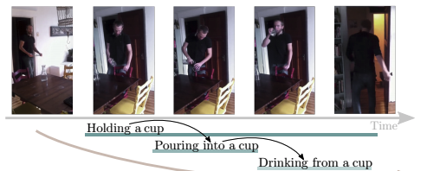
Ongoing Work: Structured Reasoning in Videos
Video understanding can be seen as one of the hardest task in CV and is obtaining more and more attention these days.
Activity recognition, activity detection and video captioning etc.
Activities/actions in videos are more than just movements and trajectories, e.g. we cook to eat and we hold a cup to drink from it.
Go beyond appearance modeling
Reason about the activity sequences
Notes:
However, currently, people are trying to solve those tasks using only appearance models, which only considers overall features, without explicitly reasoning about underlying interplays.
For example, a man walks through a doorway, stands at a table, holds a cup, pours something into it, drinks it, puts the cup on the table, and finally walks away.
If we don’t reason about the interaction between objects and the relation among sequences, it would be very hard to understand those activities well.

Slide 29
Task Definition
Activity recognition:
given a video, verify whether it contains one or several of the 157 activity categories.
input: video (frame sequence)
output: the probabilities of all activity classes for the whole video
Activity detection:
given a video, detect the activities and localize the start and the end temporally.
input: video
output: the probabilities of all activity classes for every frame
Notes:
Our idea of using relational learning for video understanding will be first evaluated on these two tasks.
In the following slides, we will mainly talk about activity detection, since it is more difficult task, and once you have the results for each frame, you can easily get the result of the whole video by combining them in some ways.

Slide 30
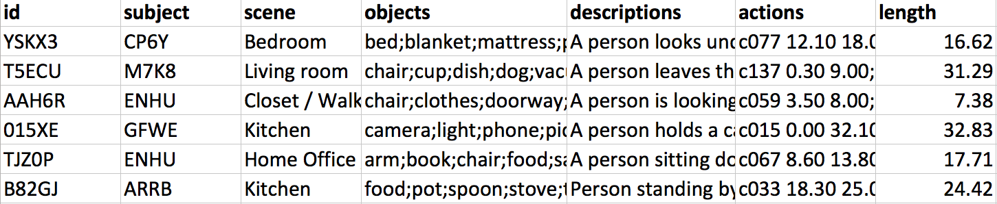
Charades Dataset
~10K videos in total
Each video is annotated by text descriptions, action labels, action intervals, classes of interacted objects and classes of verbs
157 action/activity classes
33 verb classes
38 object classes
The action is determined by verb + object
Notes:
We are training and evaluating our method on the Charades dataset, which seems to be the best fit for our idea so far.
This is how the annotations look like:
The id of the video;
Subject: the person performing the actions in the video
Scene: where the actions happen
Objects: the interacted objects
Descriptions: text descriptions of the actions
Actions: action classes and their temporal intervals
Length: the length of the video

Slide 31
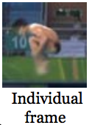
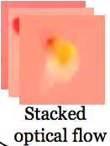
Method: Overall Architecture
LSTM
. . .
P_{activity}(t-1)
q_{o}
q_{v}
VGG-16
X_{s}
STR-Net
(Spatiotemporal Relational Network)
LSTM
q_{o}
P_{activity}(t)
q_{v}
VGG-16
X_{t}
Two-stream CNN
RL Agent
. . .
LSTM
P_{activity}(t+1)
TIME
PIPELINE
Notes:
Now lets talk about the pipeline our method.
Since we are predicting activities for each frame. We take the individual frame and the stacked optical flow as our inputs. So that we have the spatial appearance of this frame and the temporal trajectories around this frame.

Slide 32
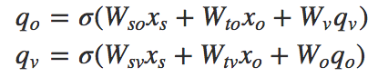
Method: STR-Net
q_{o}
Unroll the inference of CRF into
a feed-forward network
Inference Unit:
STR-Net is a stack of N inference units
The parameters of the inference units can be either shared or unshared
Dynamic network
q_{v}
X_{s}
STR-Net
(Spatiotemporal Relational Network)
q_{o}
q_{v}
X_{t}
Notes:
Learning CRF requires computing the normalizing constant Z, which can be very expensive and even intractable, especially when cycles exist in the underlying graph. Hence, approximations are often used to circumvent this problem, but they sometimes result in poor estimates.
So here we unroll the inference of CRF into a feedforward network, using the power of NN for graph relational learning.
Draw the figure on board …

Slide 33
STR-Net without sharing parameters among inference units (#units = 8)
STR-Net with sharing parameters among inference units (#units = 8)
Notes:
Here I visualize the inference and memory usage of our STR-Net.
…
Basically, sharing parameters saves a lot of space and makes the NN more generalized.
But allowing each unit have their own weights may increase the expressive power of the NN, since we have more parameters.

Slide 34
Method: RL Agent
q_{o}
q_{v}
VGG-16
X_{s}
STR-Net
(Spatiotemporal Relational Network)
LSTM
q_{o}
P_{activity}(t)
q_{v}
VGG-16
X_{t}
Two-stream CNN
RL Agent

Slide 35
Method: RL Agent
q_{o}
q_{v}
VGG-16
X_{s}
STR-Net
(Spatiotemporal Relational Network)
LSTM
q_{o}
P_{activity}(t)
q_{v}
VGG-16
X_{t}
Environment
RL Agent
BIG THREE
State: hidden states of LSTM & parameters of STR-Net
Action: prediction the activities
Reward: sample an activity for each time-step → negative 0-1 loss
Policy gradients:
update the parameters every T frames using REINFORCE
Notes:
Instead of predicting the best activity for the current frame, we aim to find the best probability distribution of the activities over time, by exploring in the action space.

Slide 36
Preliminary Experiment
Environment setting:
Torch7 + Lua
GPU GTX 1080 Ti
Preliminary results: mAP (%)
RGB frames + VGG + softmax 15.6
Flow frames + VGG + softmax 15.4
Two-stream CNN + softmax 18.9
RGB frames + VGG + LSTM 16.2
Flow frames + VGG + LSTM 16.5
Two-stream CNN + LSTM 19.8

Slide 37
Thanks!
EMNLP 2017 paper:
https://www.cs.ucsb.edu/~william/papers/DeepPath.pdf
Source code:
https://github.com/xwhan/DeepPath

